Slide 1
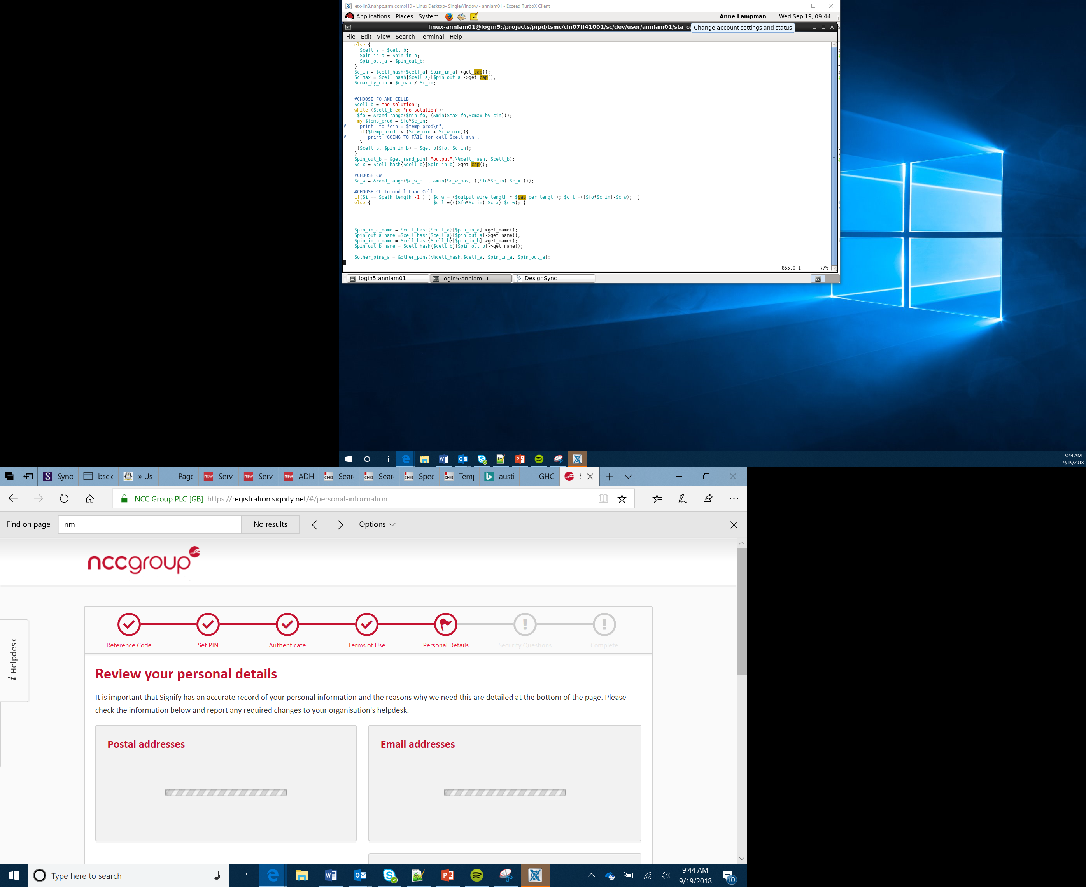

Introduction to the Arduino Cloud
Lesson 2

Slide 2
Success criteria
To understand the purpose of an algorithm
To understand how to represent algorithms using flowcharts
To understand the purpose of an IDE
To understand how functions are used
To be able to create an application on the Arduino IoT cloud

Slide 3
Planning algorithms
An algorithm is a set of step-by-step instructions which solve a problem
How can algorithms be planned?
What features should be included in an effective algorithm?
Notes:
Introduce learners to the term algorithm. Explain that it is a sequence of step-by-step instructions which, when followed solve a problem. Ask learners if they can think of any methods of planning an algorithm. Some learners may be familiar with the concepts of flow charts and pseudocode. Explain that in this lesson they will be using flow charts to plan their algorithm. Ask learners to work in pairs to identify features of an effective algorithm. Discuss findings as a group.

Slide 4
Features of an effective algorithm
An effective algorithm should:
Be specific
Complete in as few steps as possible
Always produce the correct result for any set of valid inputs
Handle erroneous inputs appropriately
Notes:
Talk through the features of an effective algorithm. Algorithms should be very precise and not open to interpretation by different people.

Slide 5
Flow charts
Your task is to develop a device which contains an LED and is connected to the IoT. The LED should be able to be turned off remotely through the use of an on screen switch. You will use this algorithm to write your code, which will control the Arduino later in the lesson.
You will need to use:
Start / Stop
Input / Output
Process
Decision
Start
Input/Output
Process
Decision
Notes:
Talk through the meaning of the different flow chart symbols. Students should then complete the flowchart which can be found on the Flowchart worksheet.

Slide 6
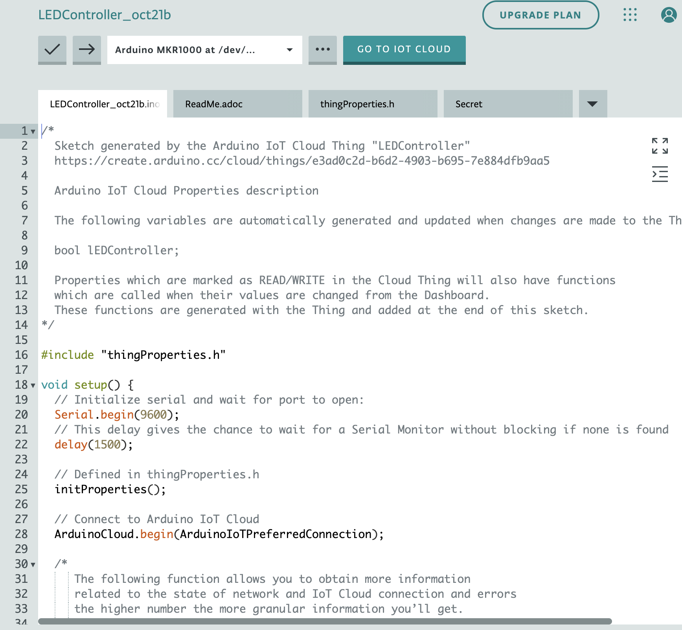
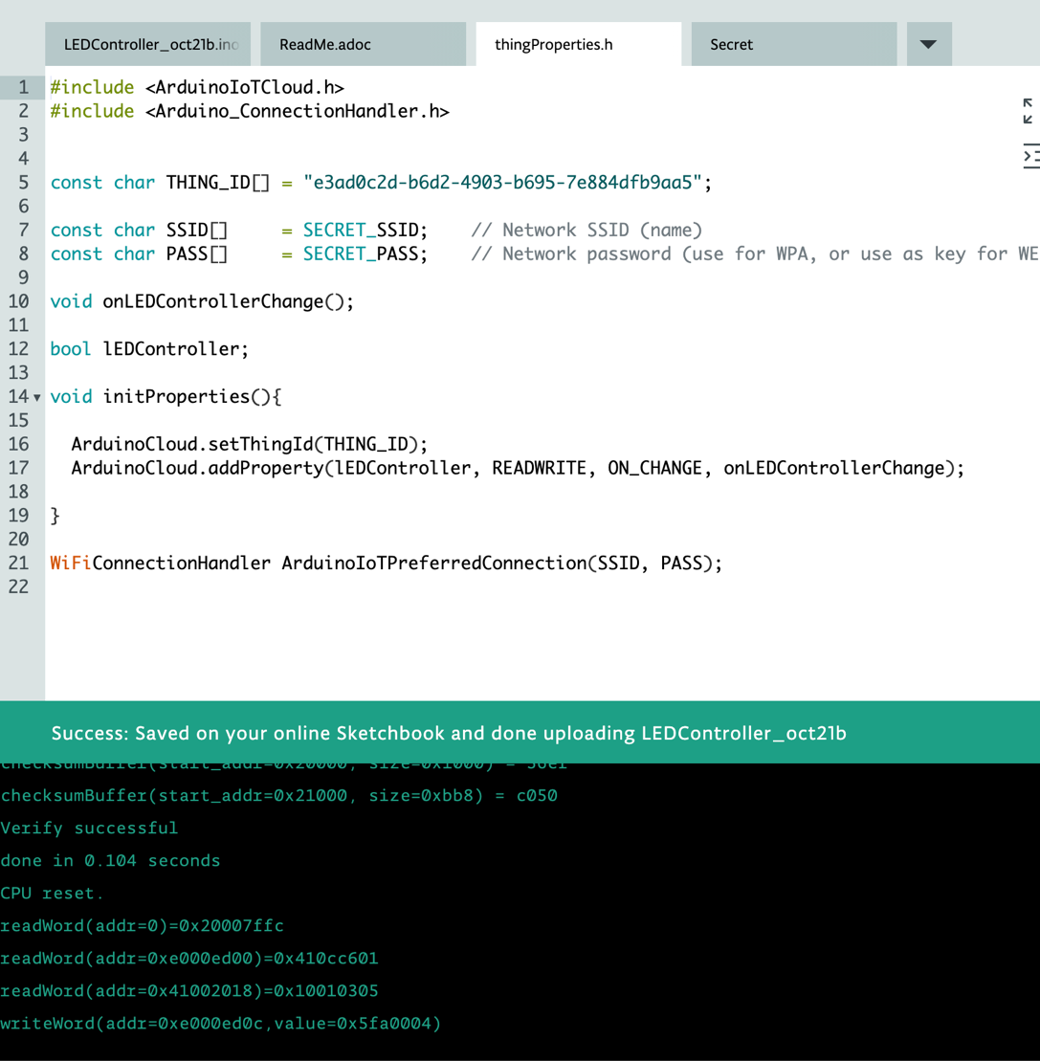
IDE
You are shortly going to use the Arduino Cloud to program your device
An IDE is an integrated development environment
What tools can you identify which the IDE provides in the screenshots below?
Notes:
Inform students that they will be using an online IDE to write their programs. Ask them to think about what tools it provides by looking at the screenshots on the slide. Draw out that there is the ability to add comments to their code, there is a built-in translator, error checking tools. Some may notice that certain key words are different colours. This is carried out by a pretty printer. It should assist learners to identify any typographical errors in their code.

Slide 7
Functions
In the screenshot below, there are four different tabs
Three of the tabs contain code which defines functions
A function is a block of code which can can be given a name and used elsewhere
The benefit of functions is that they can be reused They also help with the maintainability of code
To import a function from an external file, you use the command #include followed by the name of the file. You are then able to use any functions that have been defined within that file
Notes:
Discuss the benefits that using functions offers. Once a function has been tested, it can be used elsewhere with confidence that it will work. Discuss line 16, which uses code that is defined in thingsProperties.h. Point out that this is the name of one of the other tabs. This means that the code that is written in that file can be used within the LEDController file.

Slide 8
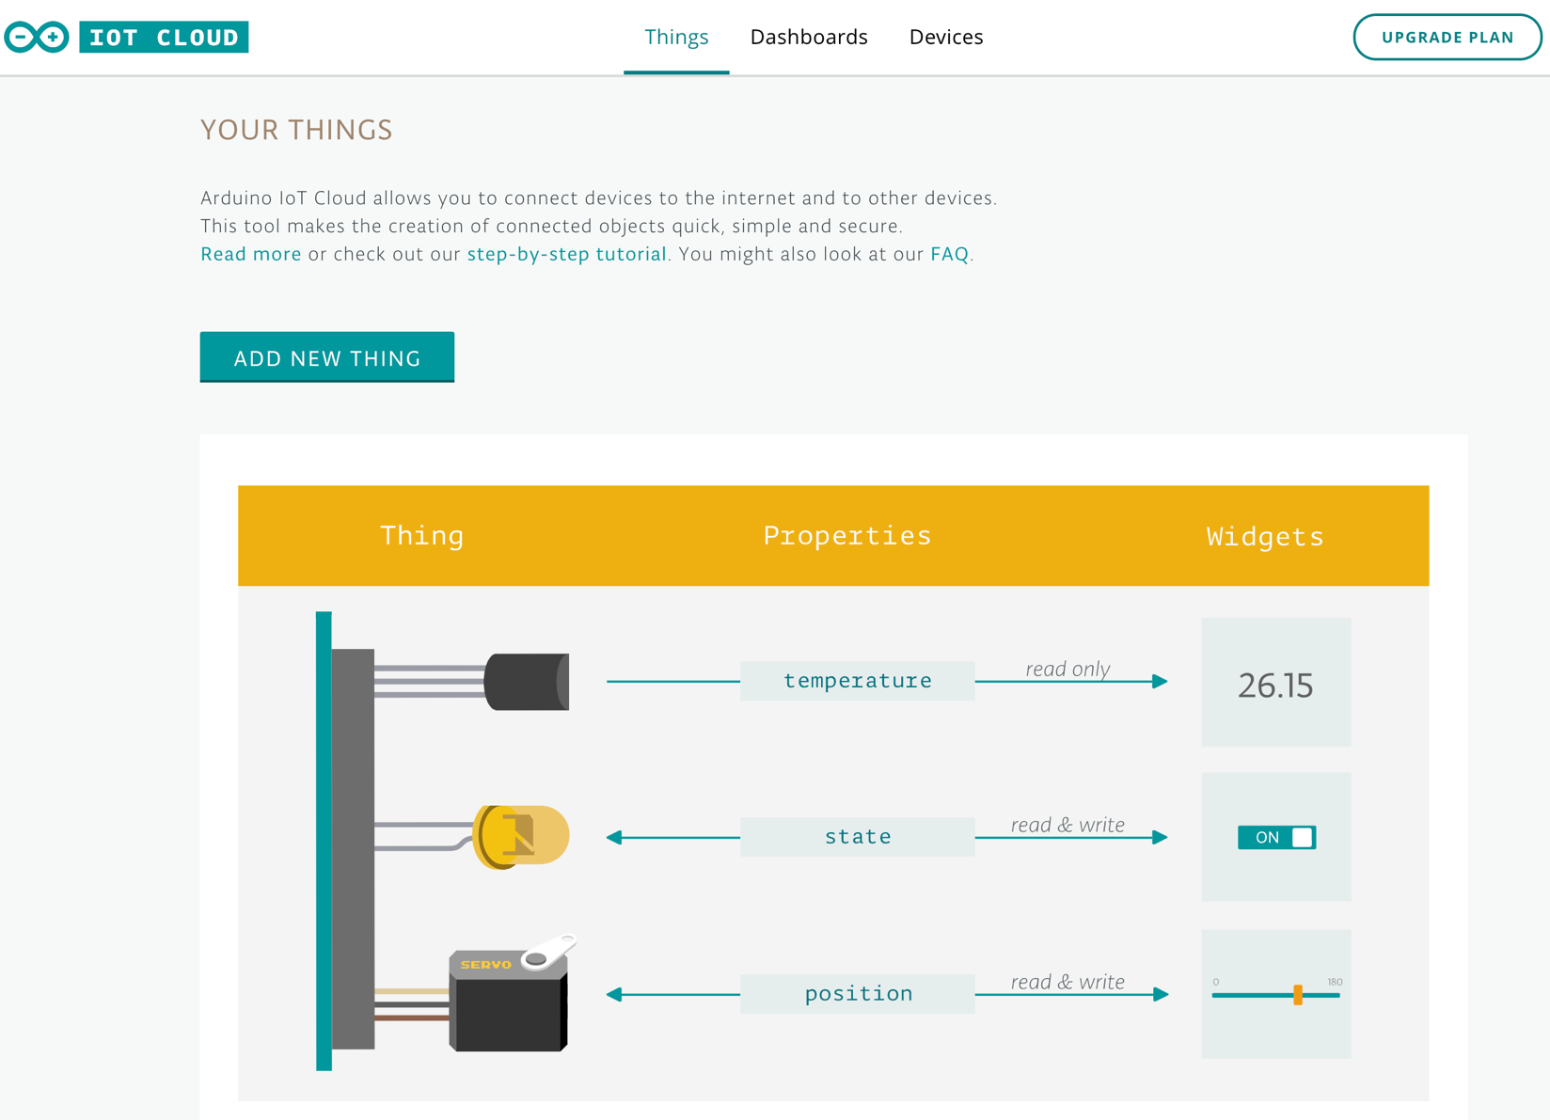
The Arduino IoT cloud
There are three key elements of the IoT cloud
A place to create a new ‘thing’
An IDE to write the code for your ‘thing’
A place to create a GUI dashboard to control your thing
Notes:
Highlight the three elements of the IoT Cloud. These can be accessed through clicking on the tabs across the top.

Slide 9
Your task
Using the Arduino cloud worksheet, you are going to program your MKR1000 device
You will develop an online switch which turns the LED on and off remotely
Remember to follow the instructions carefully
Notes:
Introduce learners to the task and inform them how to access the worksheet. Learners should then carefully work through the worksheet.

Slide 10
Summary
Algorithms can be planned using flowcharts
Effective algorithms need to be as efficient as possible
The flow chart is used to plan the structures that will need to used to write a program. In this project, you planned your algorithm using the flowchart to control an LED and then implemented it using code written in the Arduino IoT cloud
Functions allow blocks of code to be reused
The Arduino IoT cloud allows you to create device, which can be controlled over the Internet

